Slide 1

Tutorial 8
Binary Search Tree & AVL Tree
Xi Chen
E-mail: xichen7@link.cuhk.edu.cn
Notes:
hello everyone, this is the tutorial 4 function, today, firstly, we will do a quick recap of the function and explain some exercises

Slide 2
Outline
Recap
Exercises

Slide 3
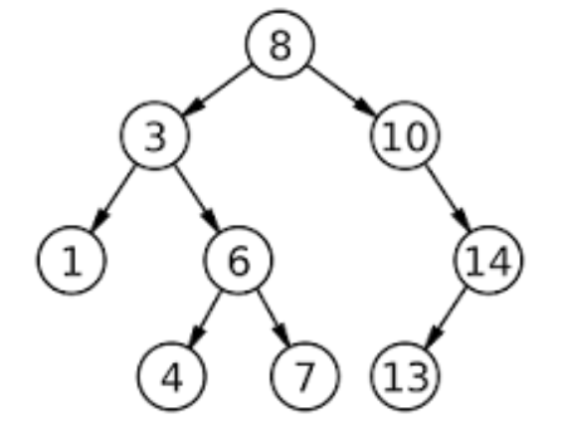
Recap
Binary Search Tree(BST)
BST is a tree such that for each node T
  the key values in its left subtree are smaller than the key value of T
  the key values in its right subtree are larger than the key value of T
Notes:
- There are two types of functions in Python
1.Built-in functions which are part of Python, such as print(), int(), float(), etc
2.Functions that we define ourselves and then use

Slide 4
DFS and BFS
Depth First Search (DFS)
In this strategy, we adopt the depth as the priority, so that one would start from a root and reach all the way down to certain leaf, and then back to root to reach another branch.
The DFS strategy can further be distinguished as preorder, in-order, and post-order depending on the relative order among the root node, left node and right node.
Breadth First Search (BFS)
We scan through the tree level by level, following the order of height, from top to bottom. The nodes on higher level would be visited before the ones with lower levels.
Notes:
Use the def keyword with the function name to define a function.
Next, take two parameters
Print them using the print() function
Call function by passing name and age.
ok, this is very easy and basic.

Slide 5
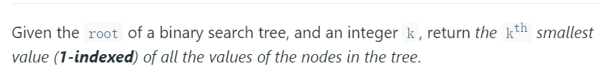
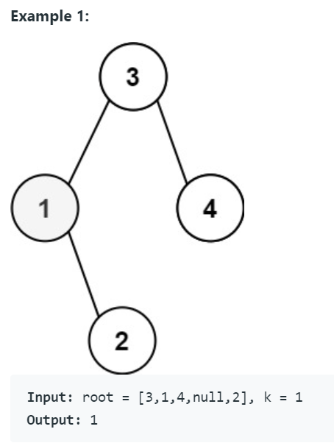
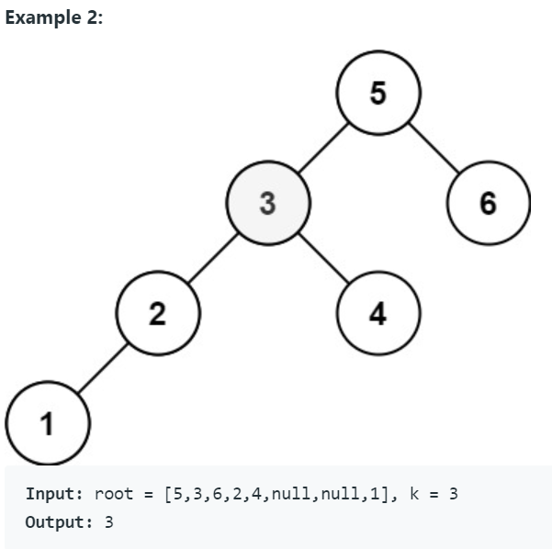
Ex1: Kth Smallest Element in a BST
Notes:
Let's look at the first exercise，this is a simple problem. and now we look at the solution

Slide 6
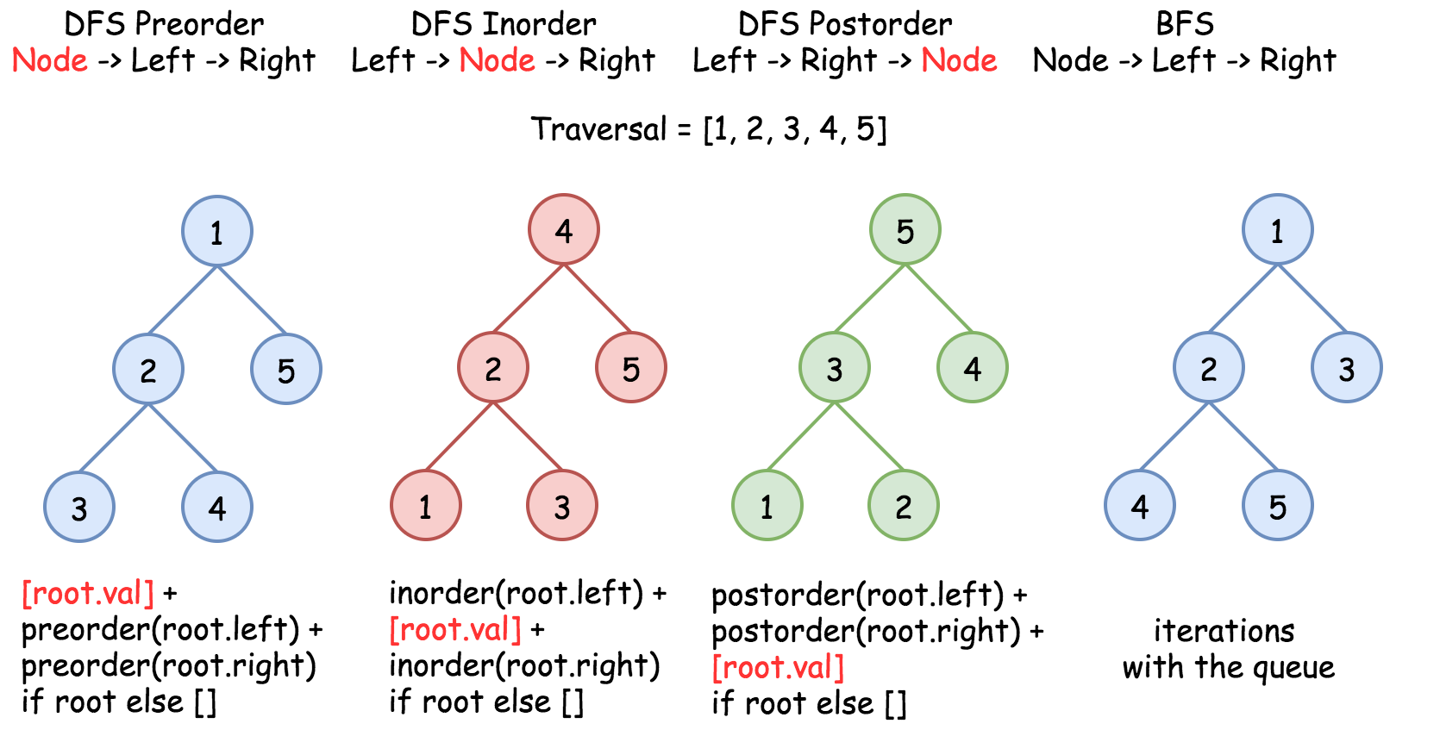
Ex1: DFS and BFS
Notes:
Use the def keyword with the function name to define a function.
Next, take two parameters
Print them using the print() function
Call function by passing name and age.
ok, this is very easy and basic.

Slide 7
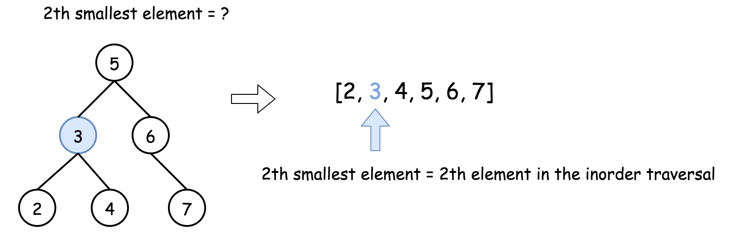
Ex1: Solution
To solve the problem, one could use the property of BST : inorder traversal of BST is an array sorted in the ascending order.
Approach 1: Recursive In-order Traversal
It's a very straightforward approach with O(N) time complexity. The idea is to build an inorder traversal of BST which is an array sorted in the ascending order. Now the answer is the (k – 1)th element of this array.
Notes:
Use the def keyword with the function name to define a function.
Next, take two parameters
Print them using the print() function
Call function by passing name and age.
ok, this is very easy and basic.

Slide 8
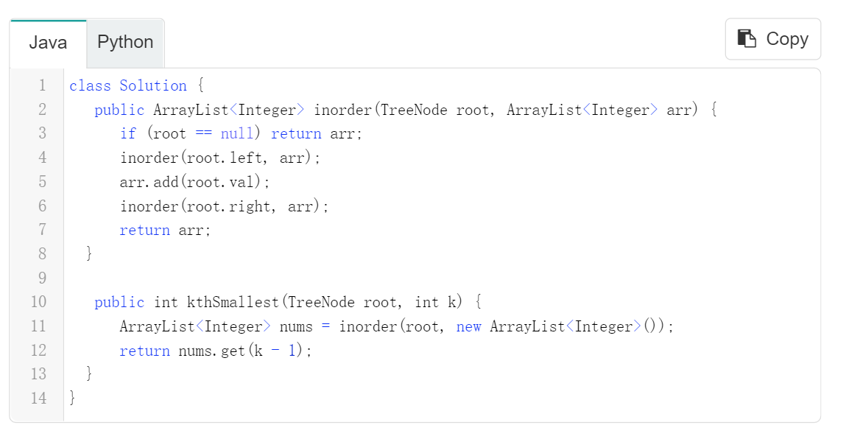
Ex1: Solution(Java)
Notes:
Use the def keyword with the function name to define a function.
Next, take two parameters
Print them using the print() function
Call function by passing name and age.
ok, this is very easy and basic.

Slide 9
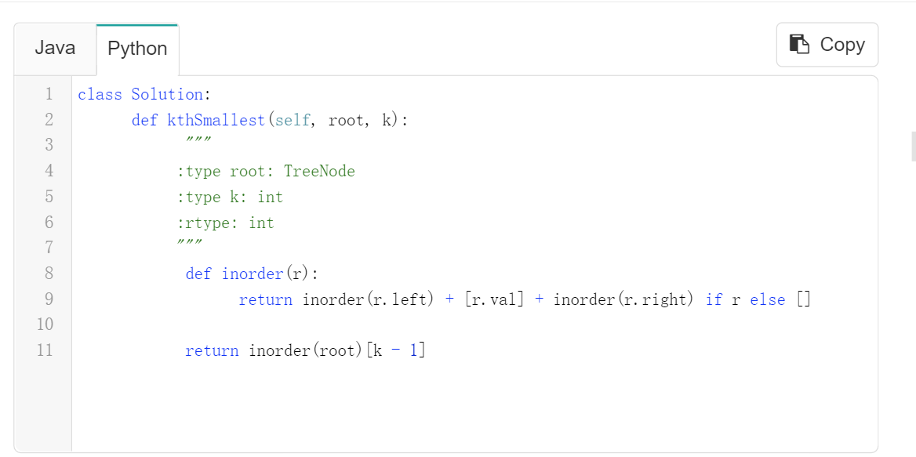
Ex1: Solution(Python)
Notes:
Use the def keyword with the function name to define a function.
Next, take two parameters
Print them using the print() function
Call function by passing name and age.
ok, this is very easy and basic.

Slide 10
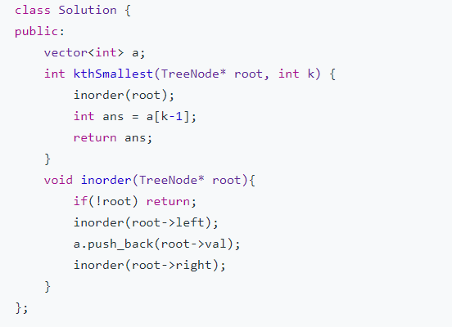
Ex1: Solution(C++)
Notes:
Use the def keyword with the function name to define a function.
Next, take two parameters
Print them using the print() function
Call function by passing name and age.
ok, this is very easy and basic.

Slide 11
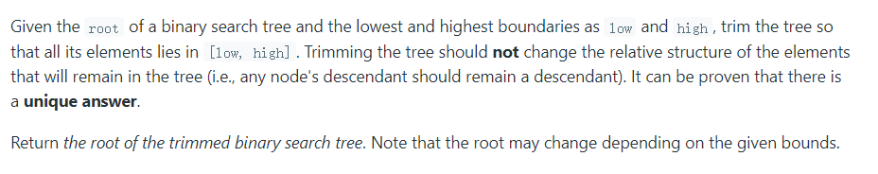
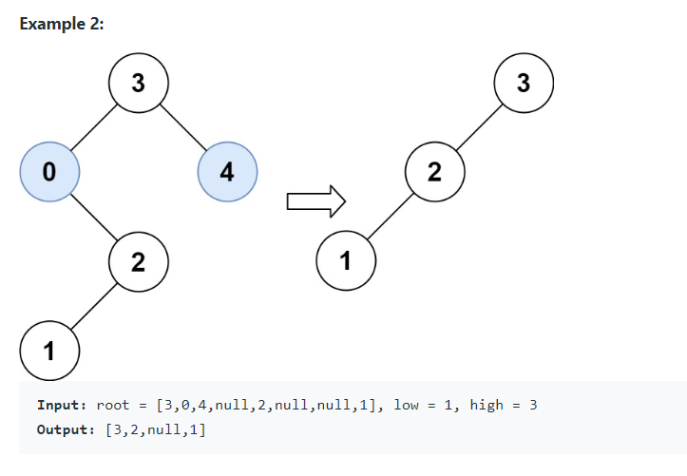
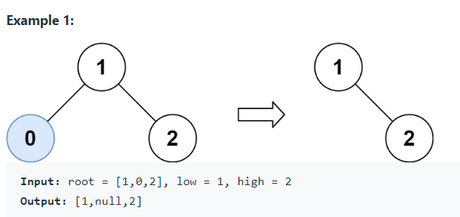
Ex2: Trim a Binary Search Tree

Slide 12
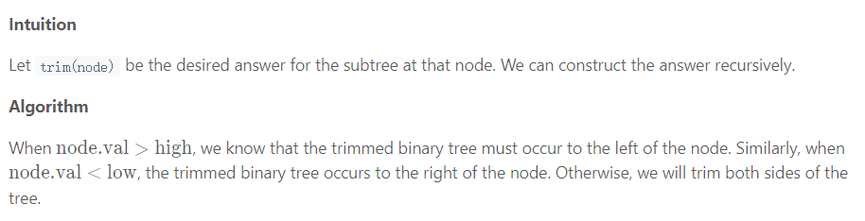
Ex2: Hint
Notes:
The target codes have been given a part，you should base it and complete it. ok let’s look at the solutions

Slide 13
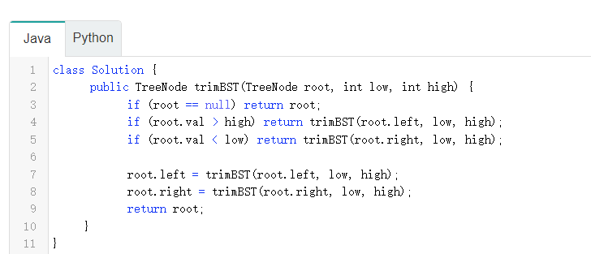
Ex2: Solution-1(Java)
Notes:
the simplest one method that we think of if create a variable called addition that stores the result of a plus b, and create another variable called subtraction that stores the result of a minus b. then return multipule values separated by comma. the output of calculation is given to the variable called res, and the res is a tuple (50, 30)

Slide 14
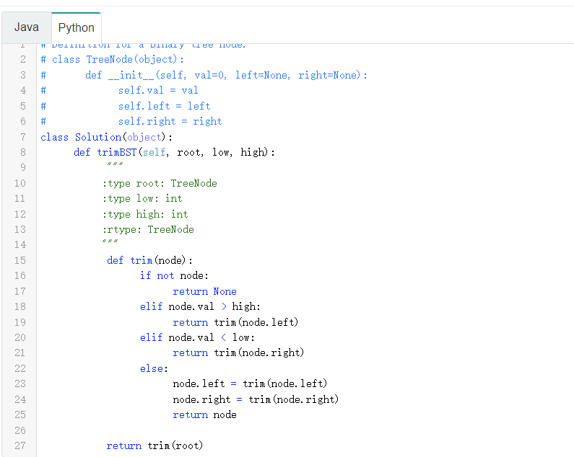
Ex2: Solution-1 (Python)
Notes:
we can also simplify the solution 1, we could directly return the result of a plus b and a minus b, which can save the memory when run the program and also make the function looks more simple. we can use two variables to receive the output of the calculation function. and the add and sub variable are both int type.

Slide 15
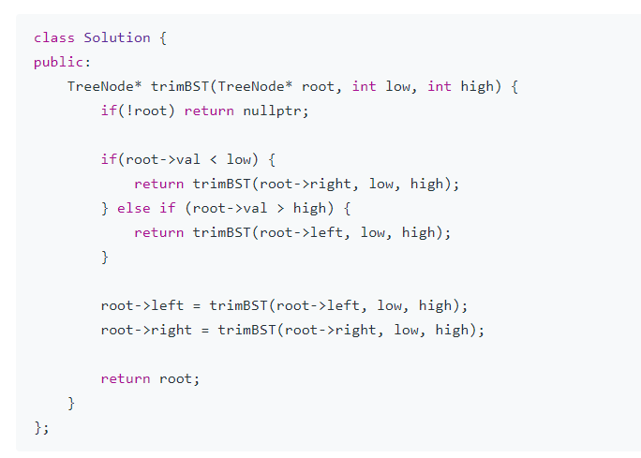
Ex2: Solution-1(C++)

Slide 16
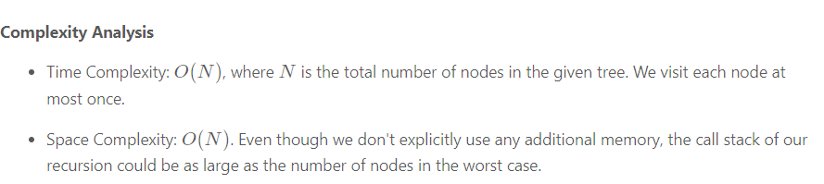
Ex2: Complexity

Slide 17
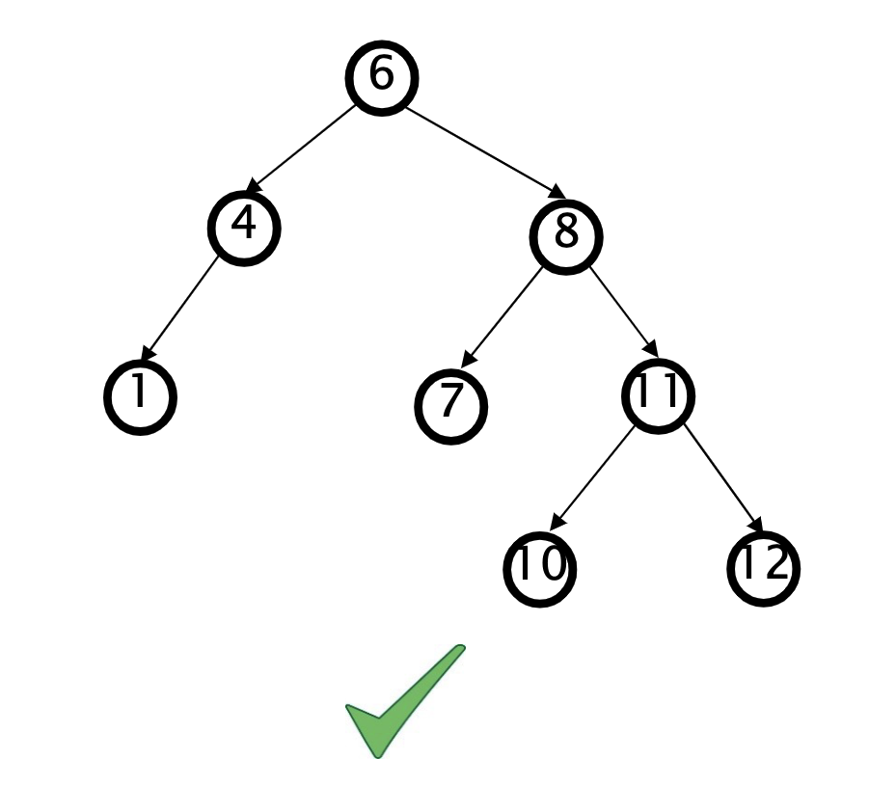
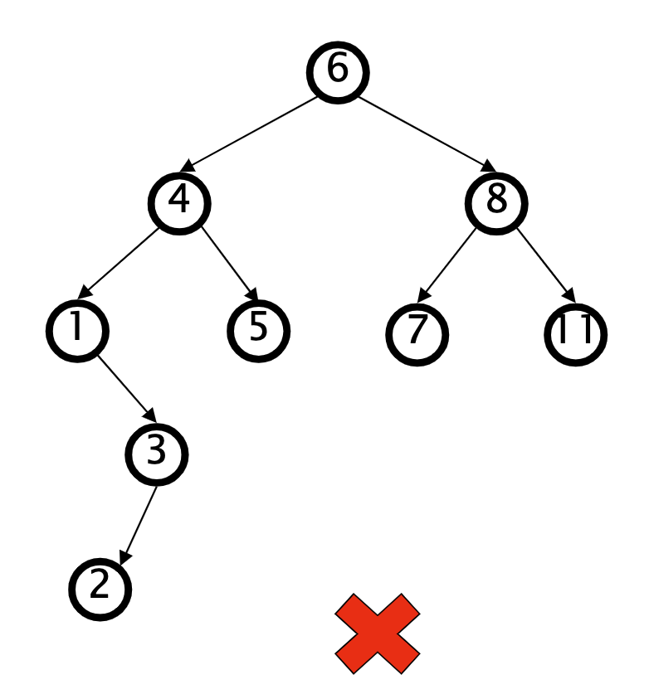
Recap
AVL Tree
An AVL tree is a self-balancing BST
  For every node in the tree, the height of the left subtree differs from the height of the right subtree by at most 1
  If at any time they differ by more than one, rebalancing isdone to restore this property
Notes:
- There are two types of functions in Python
1.Built-in functions which are part of Python, such as print(), int(), float(), etc
2.Functions that we define ourselves and then use

Slide 18
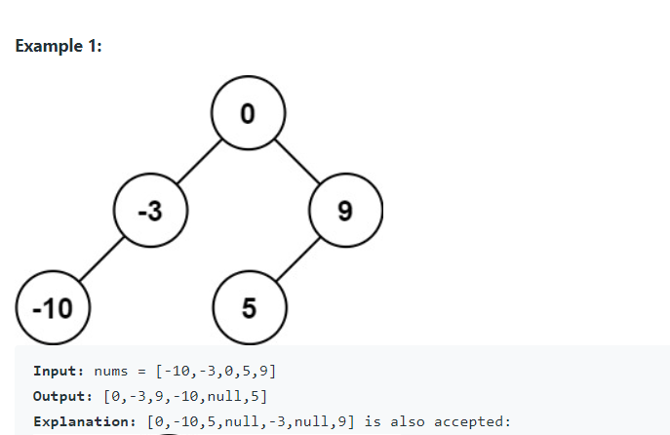
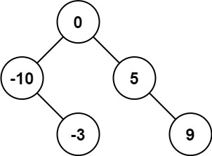
Ex3: Convert Sorted Array to Binary Search Tree
Given an integer array nums where the elements are sorted in ascending order, convert it to a height-balanced binary search tree.

Slide 19
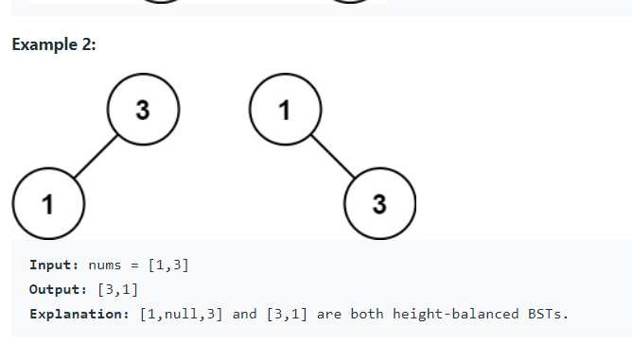
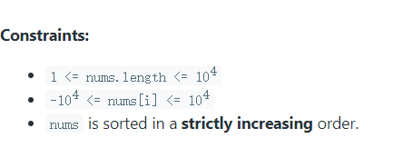
Ex3: Convert Sorted Array to Binary Search Tree
Given an integer array nums where the elements are sorted in ascending order, convert it to a height-balanced binary search tree.

Slide 20
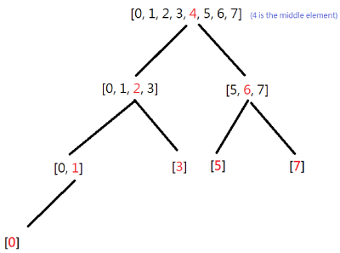
Ex3: Hint(Recursion)
Since nums is a sorted list, the middle element nums[len(nums)//2] must be the root node of nums.
Thus, after setting the middle element be the root, finding the middle element in the left subarry nums[:len(nums)//2] and right subarry nums[len(nums)//2 + 1 :]
For example, nums = [0, 1, 2, 3, 4, 5, 6, 7]
Notes:
the hint shows that how to use the fucntion and display the output of the fucntion, you know, we learned the parameter and the equal sign and the default value can support the fucntion having default argument.

Slide 21
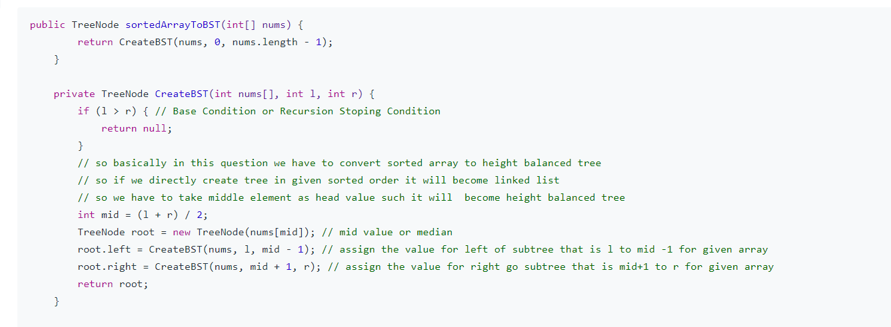
Ex3: Solution(Java)
Notes:
Default arguments take the default value during the function call if we do not pass them. For example, , it is equal to the default value. We can assign a default value to an argument in function definition using the = assignment operator.

Slide 22
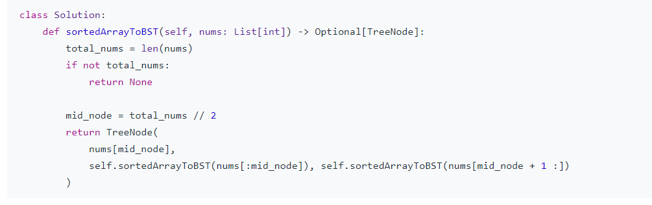
Ex3: Solution(Python)
Notes:
Default arguments take the default value during the function call if we do not pass them. For example, , it is equal to the default value. We can assign a default value to an argument in function definition using the = assignment operator.

Slide 23
Thanks

